Slide 2
Table of content
Legalisation procedures – temporary residence permit for non EU full-time students
Information for EU full-time students
AMU Welcome Center

Slide 3
Legalisation procedures – temporary residence permit for non EU full-time students

Slide 4
Apllying for residence
Submittion of application
Where?
Poznań and regional offices in Kalisz, Konin, Leszno, Piła
How?
In person
Via post (procedure last longer) – later originals of passport must be presented and fingerprints are required to be provided
When?
no later than on the last day before the expiration of visa, non-visa traffic, residence card
the appointment to apply needs to be set through: 1)https://www.poznan.uw.gov.pl/rejestracja/
2) FOR STUDENTS ONLY – AMU Welcome Center*
Appointment for fingerprint – setting appointment via case status tracking portal after receiving letter from our office

Slide 5
Immigration Consulting Point at AMU WELCOME CENTER
open every Wednesday from 8.00 am till 4 pm.
location: AMU Welcome Center, Święty Marcin 78 Street /corner of Kościuszki Street (ground floor), Poznan
for students only:
get information regarding residence permit procedures
get help in filling out application forms regarding residence permit
schedule a near term appointment at the Department for Foreigners to apply for temporary residence permit with personal appearance & fingerprints
book a visit by phone: 61 829 44 34 /email: welcome@amu.edu.pl
Or just come and check ☺

Slide 6
Documents to submit
application form
Link to the form you can find here (choose: Applications - temporary residence permit) : https://migrant.poznan.uw.gov.pl/en/do-pobrania/applications-temporary-residence-permit-forms-proceedings-started-after-april-27-2019
Filled out online application forms at MOS https://www.mos.cudzoziemcy.gov.pl/
photocopy of your passport (original needs to be shown)
proof of payment of the stamp duty - 340 PLN
4 biometric PHOTOS (face front, not older than 6 months)
current proof of valid health insurance
current documents confirming financial resources
current confirmation letter from university (in Polish)
a filled in and signed declaration regarding housing costs
link to the form you can find here: https://migrant.poznan.uw.gov.pl/en/do-pobrania/declaration-regarding-cost-housing-students

Slide 7
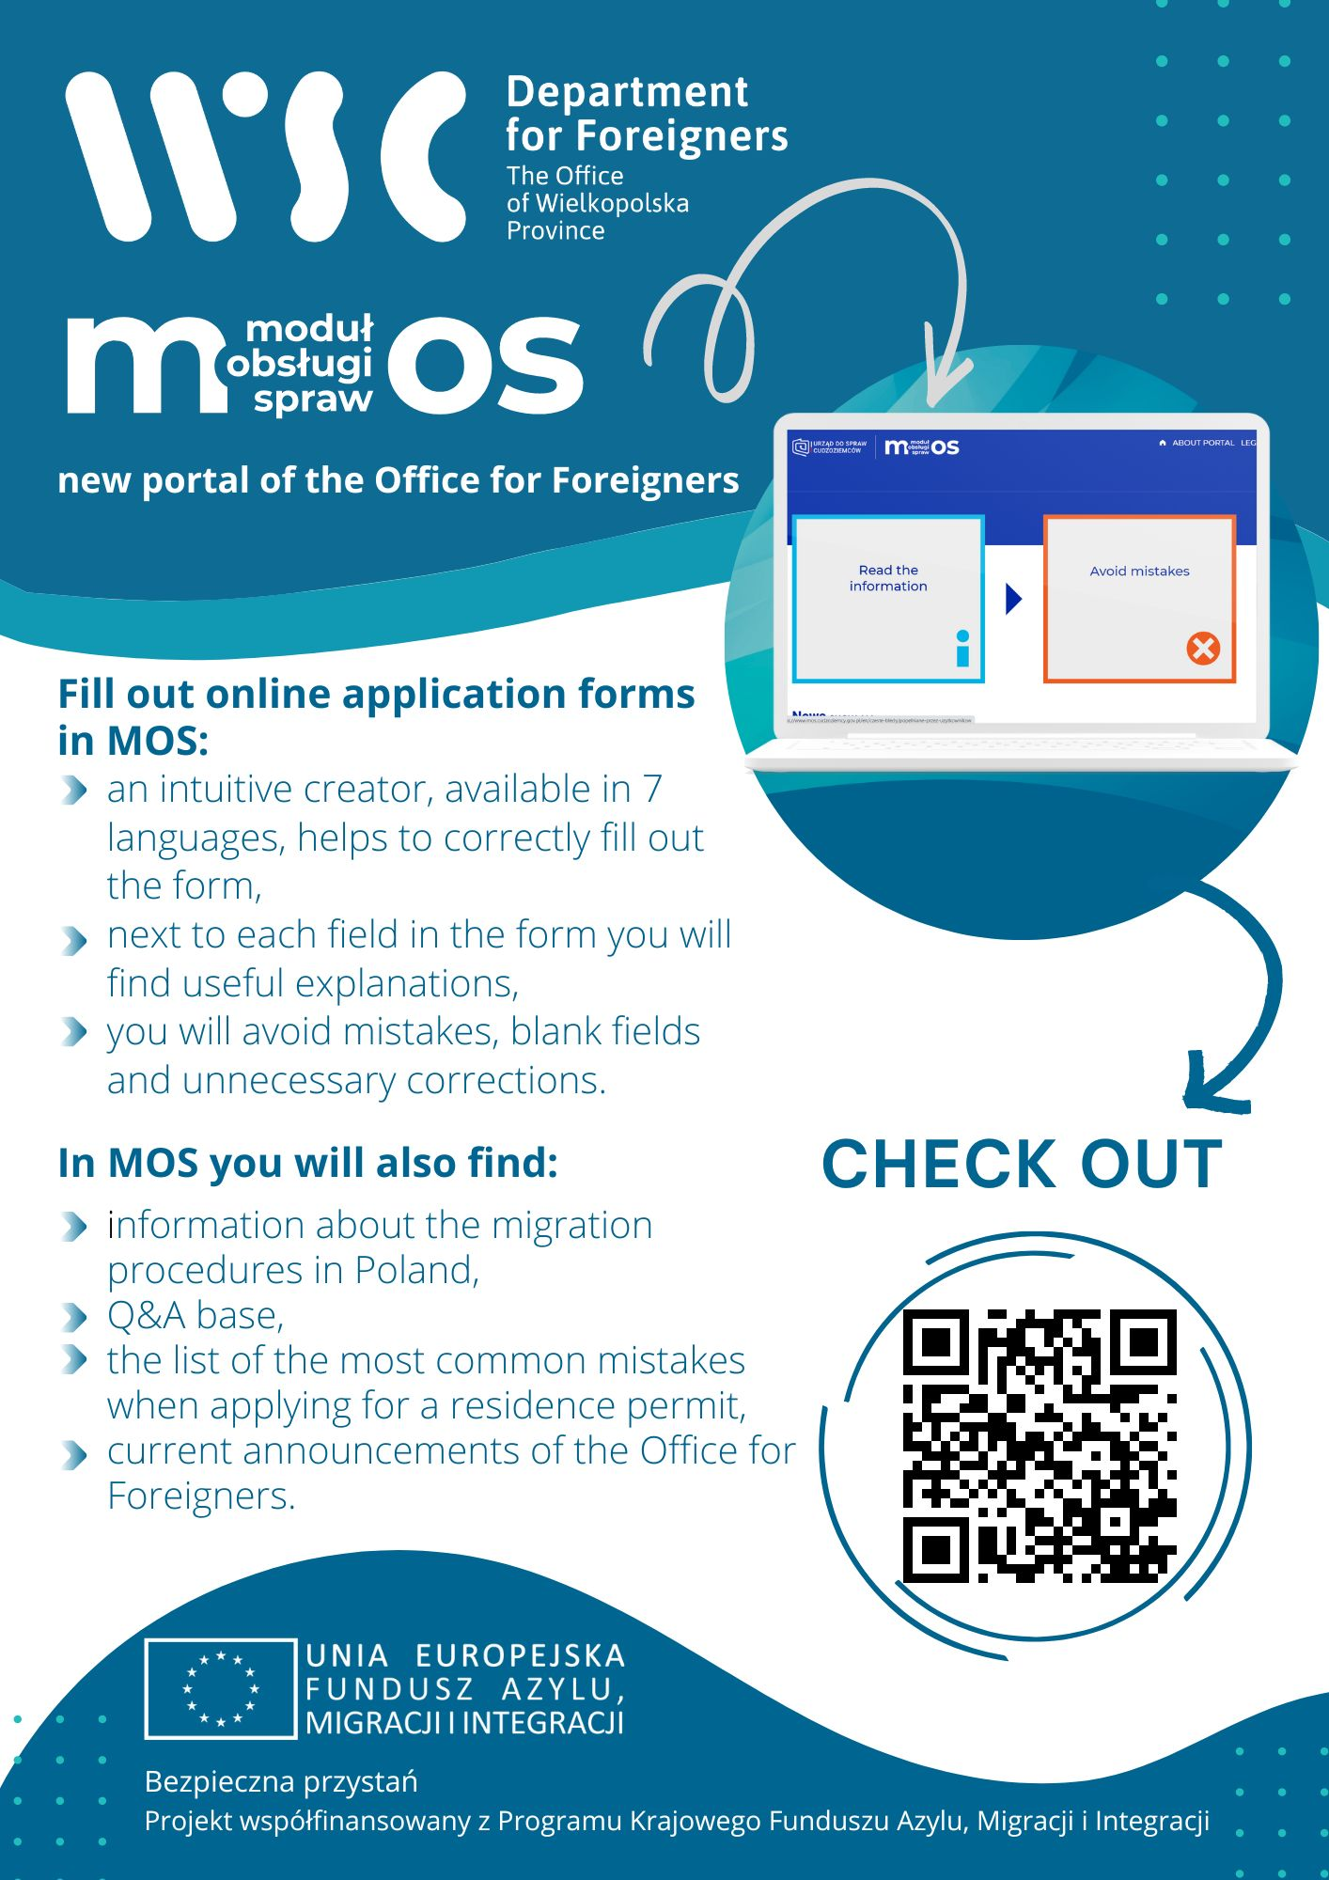
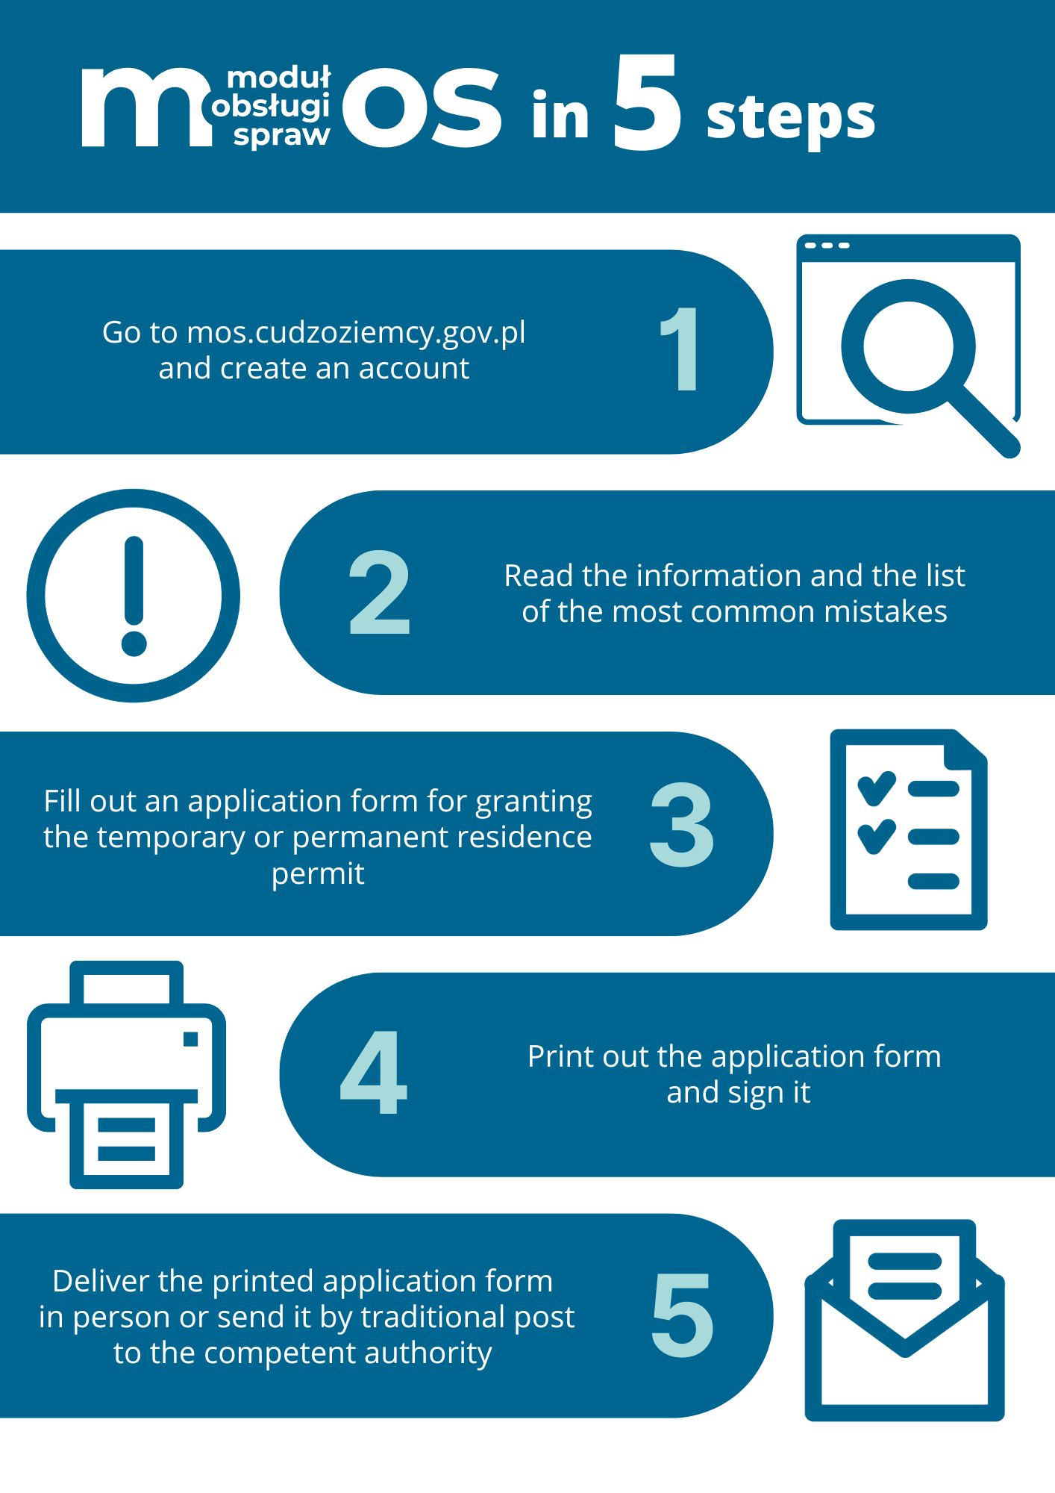

Slide 8
Confirmation letter from university
Confirmation letter from university
Signed by authorised person (rector/person authorised by rector)
Valid for a given semester!
Prepared on the correct form
With a copy of the evaluation card included (when continueing studies)
Proof of payment of the tuition fee
Information regarding the payment of the tuition fee in the current semester, included in the above-mentioned confirmation letter
A separate certificate from the university confirming the payment of tuition fees in a given semester/academic year
Information on exemption from tuition fees included in the above-mentioned certificate of continuing studies
Proof of payment of the tuition fee for a given semester / year of study with a document confirming the amount of tuition fees (contract concluded with the university, etc.)

Slide 9
Health Insurance Private health insurance Contract with NFZ (National Health System)
Insurance must cover all medical expenses in Poland
Insurance must be valid on the day when the permit is granted
Original policy must be presented
Contract & proof of payments
If insurance is not in Polish it should be submitted together with official translation into Polish
If the policy is concluded electronically, this must be clearly indicated in the document (e.g., electronic document); failure to do so requires submission of the original document signed by a representative of the insurance agency (original for reference)
Electronically signed documents must be submitted electronically to allow signature verification
Original contract
proof of payment of insurance fees, paid on time!

Slide 10
Financial resources 776PLN per month (600zł if family members are in Poland), after deducting cost of housing*, with reference to the period of studies
200zł for the return ticket (for countries neighboring Poland)
2500zł for the return ticket (for other countries)
Official scholarship (national or foreign)
Current bank statement from a bank situated in Poland/UE – signed and stamped by a bank representative
Certificate from a bank with the information about the limit on your credit card
certificate of employment and amount of salaries,
Original of the certificate + official translation into Polish; documents issued not earlier than one month before the date of submitting an application for a temporary residence permit
How to count sufficient funds for living in Poland?
https://migrant.poznan.uw.gov.pl/en/faq/what-amount-financial-resources-i-should-have-be-granted-temporary-residence-permit-purpose
*Housing costs do not refer to citizens of Belarus

Slide 11
Housing costs
The cost of living includes:
Lease
Utilities, including: energy, gas, water, sewage, waste
How to confirm it:
signed declaration regarding housing costs: https://migrant.poznan.uw.gov.pl/pl/do-pobrania/oswiadczenie-dot-kosztow-zamieszkania-studenci
Certificate from the student dormitory about the amount of accommodation costs per month
If you change a place of residence, the office must be informed about it and a new declaration of the cost of residence must be submitted

Slide 12
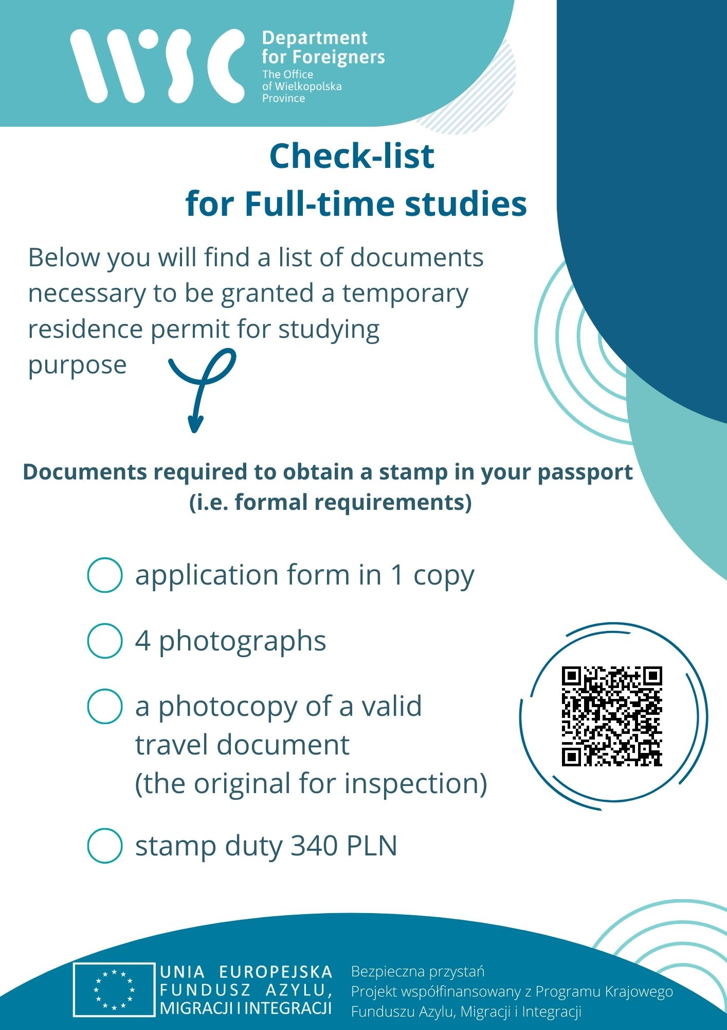
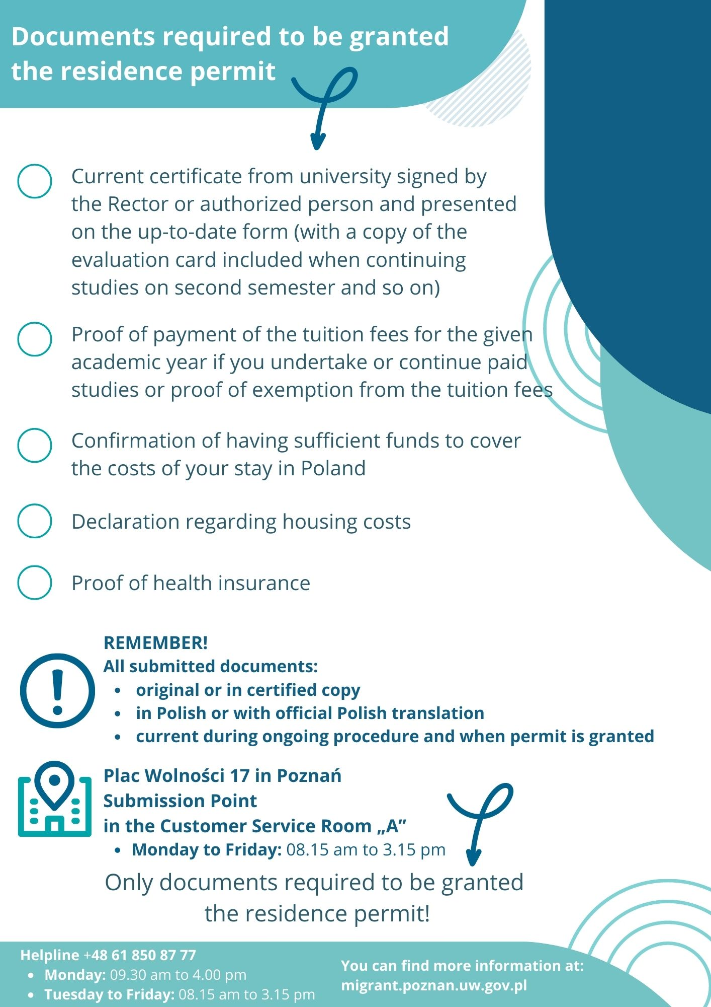
Check – list for full-time students

Slide 13
Common mistakes
Confirmation letter from university
Out-of-date
Signed by the person who is not authorised by rector/prepared on the incorrect form
No evaluation card included
Confirmation of tuition fee payments
Out-of-date
Late in payment of tuition fees
Insurance
It does not cover the costs of medical expences in Poland
There are no valid confirmations of payment for the policy
There is no original / sworn translation into Polish
Financial resources
Out-of-date/insufficient when taking into account the period of study and the indicated amount of the housing costs
Certificate from the bank not signed&stemped by the bank representative / issued earlier than the proof of payment of tuition fees
Declaration regarding housing costs
Out-of-date/not signed

Slide 14
Duration of the residence permit
The first permit (the first year of first / second cycle studies or doctoral school) is granted for a period of:
15 months
for the duration of the academic year or studies extended by 3 months - if the study period is shorter than 15 months
2 years if the studies are covered by the EU program etc.
The next permit (the subsequent year of study) is granted for a period of:
the duration of studies extended by 3 months, but no longer than 3 years

Slide 15
Residence card
The procedure terminates with an administrative decision
Residence card
Confirmation of registered residence or Statement about the residence card printout without an address
Proof of payment for the card 50zł
The residence card is to be collected in person only (after 2-4 weeks time)

Slide 16
Important matters
Collect your mail
Check the status of your case on our website
Originals of all documents must be presented or submitted at the office
All the documents are to be submitted in Polish or with official translation into Polish

Slide 17
Bank account numbers
Payment for the temporary residence permit 340zł
Urząd Miasta Poznania Wydział Finansowy
Oddział Pozostałych Dochodów Podatkowych i Niepodatkowych,
61-706 Poznań, ul. Libelta 16/20; PKO BP S.A.
Bank account number: 94 1020 4027 0000 1602 1262 0763
Payment for the temporary residence card 50zł
Wielkopolski Urząd Wojewódzki,
al. Niepodległości 16/18 Poznań,
Bank account number: 70101014690000392231000000

Slide 18
Temporary residence permit – do it yourself 5 steps to submit an application - it's simple !
2. Fill out application
according to the instructions
4. Come to the
office at the
appointed time
1.Log in
to MOS
3. Schedule
an appointment
5. Submit your
application

Slide 19
Legalisation Procedure - EU citizens+Switzerland and Norway

Slide 20
EU Students
Registration of residence
Application form
https://migrant.poznan.uw.gov.pl/pl/do-pobrania/wniosek-o-zarejestrowanie-pobytu-obywatela-ue
4 biometric photographs
Health insurance
European Insurance Card (EKUZ in Polish)
Proof letter from University in Polish
Passport or national ID
Statement confirming the source of income
Apply in person

Slide 22
Plac Wolności 17, 61-739 Poznań
Information: +48 61 850 87 77
Website: www.migrant.poznan.uw.gov.pl
WSC CONTACT portal !!!
Office hours: Mon: 9:30-6:00pm
Tue-Fri: 8:15-3:15pm
Submittion Point hours (for additional documents only /not for apllying for temporary residence permit):
Mon-Fri 8:15am - 3:15pm
Information Point hours:
Mon: 10:30am - 6:00pm
Tue-Fri: 8:15-3:15pm
Immigration Consulting Point at AMU Welcome Center (Św. Marcin 78 Street,Poznań):
Wed: 8:00am-4:00pm

